Slide 1
CIFAR-10 Classification with CNNs
An academic overview of building and evaluating a Convolutional Neural Network for image classification.
1
2
3
CIFAR-10 Dataset
CNN Architecture
Data Preprocessing
60,000 images across 10 distinct classes.
Utilizing Conv2D, MaxPooling, Flatten, and Dense layers.
Techniques for preparing images for model training.
4
5
Model Evaluation
Key Insights
Assessing performance with accuracy and loss metrics.
Improvements and future directions for the model.

Slide 2
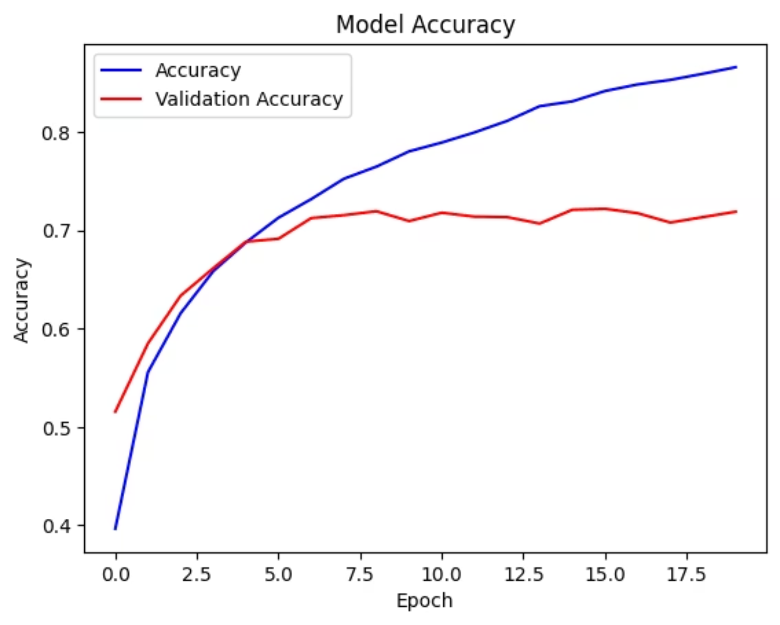
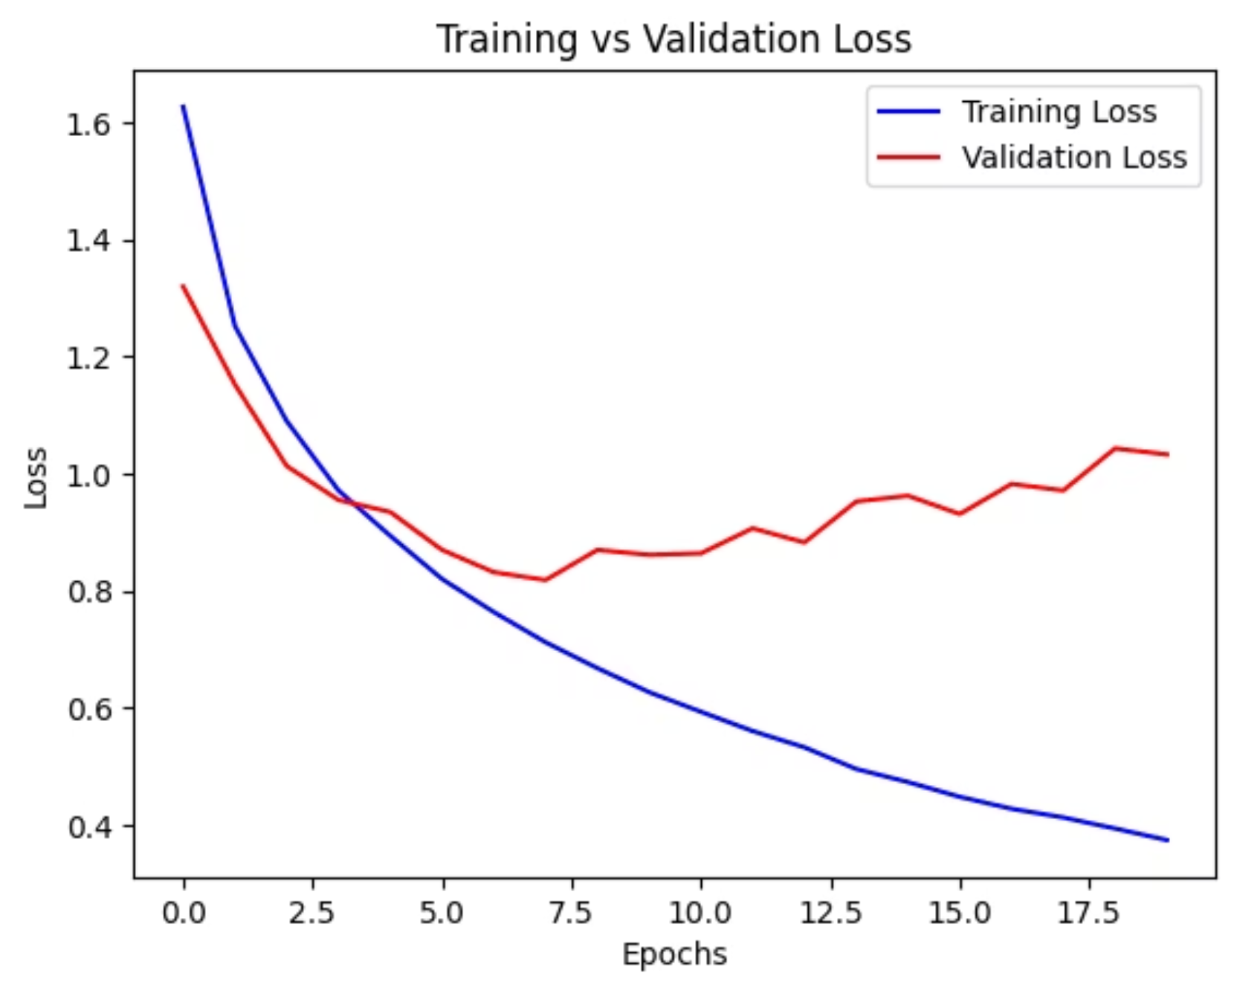
Graphs
Model Accuracy
Training Vs Validation Loss

